Slide 1

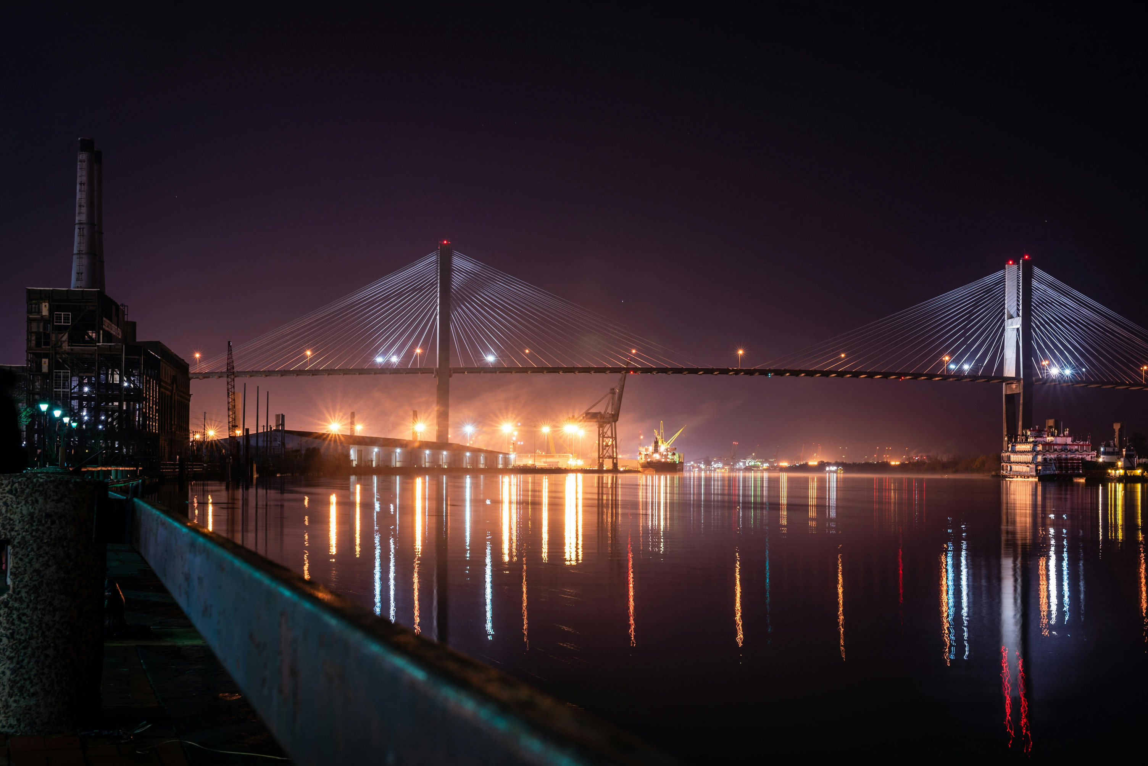

Celebrating the life of
Olivia Wilson
January 9,1980-Agustus 20,2024
Funeral Service:
Agustus 20,2024 | at 3:00pm
123 Anywhere st., Any City, ST 12345

